Slide 1
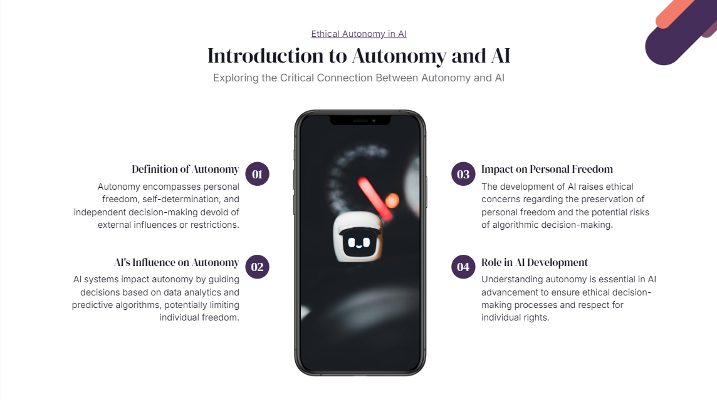
Notes:
Theoretical Sense of freedom - life determined by rules and apply rules to self
Philosophical Sense Extremes:
Rules by others (constrained)
No Rules to guide actions or purpose or intention (acting pointlessly - do not think that is freedom. This is random action)
In order to be free there must be clear rules to existence and apply to myself
Between slavery and randomness
Between others’ purpose and no purpose
Self determination
Social definition of freedom: Freedom maximization / freedom
You can do whatever you want .. up to the point where it interferes with others doing what they want (when your activities stop people from exercising their freedom)
Drinking driving pictures (1st picture) freedom to drink (unseen environment - free to do so - do whatever you want) (2nd picture) drinking while driving (taking away someone’s freedom)
Practical definition of freedom:
Physically free: not constrained/compelled
Mentally informed: not misinformed (not uninformed?) informationally free. Understand whats going on around you
Psychologically reasonable: not drugged, not altered, sleepwalking, etc.

Slide 2
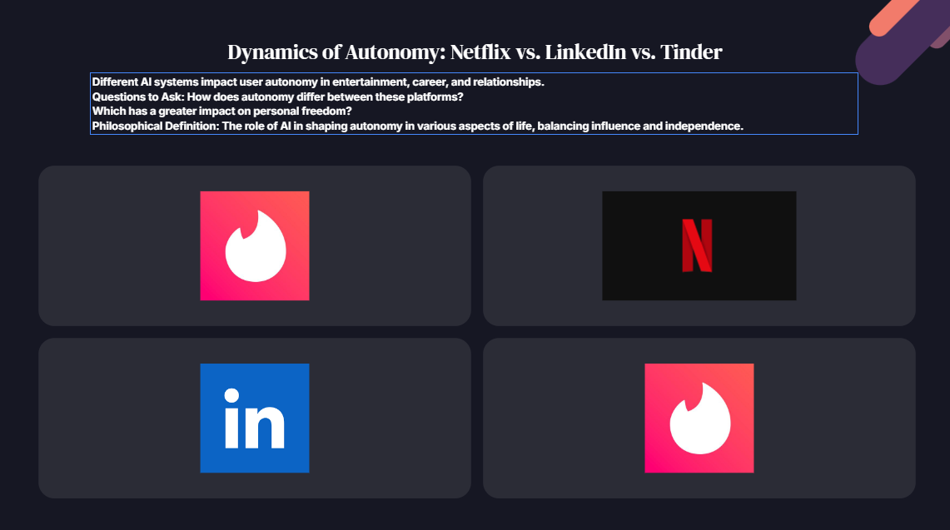
Notes:
HyperLinkedIN, TInder, Netflix: Does this limit possibilities or increase freedom?
There is value when you figure things out yourself!

Slide 3
Locke’s Locked Room Experiment
Don’t want to get out! Do not realize door is locked! Are you free?
Perspective 1) Feeling content, free in sense of being or knowing you are locked in!
Perspective 2) No personal development (specific freedom lost) Cannot change your mind!
No “correct” answer to freedom question! The beauty of ethics!

Slide 4
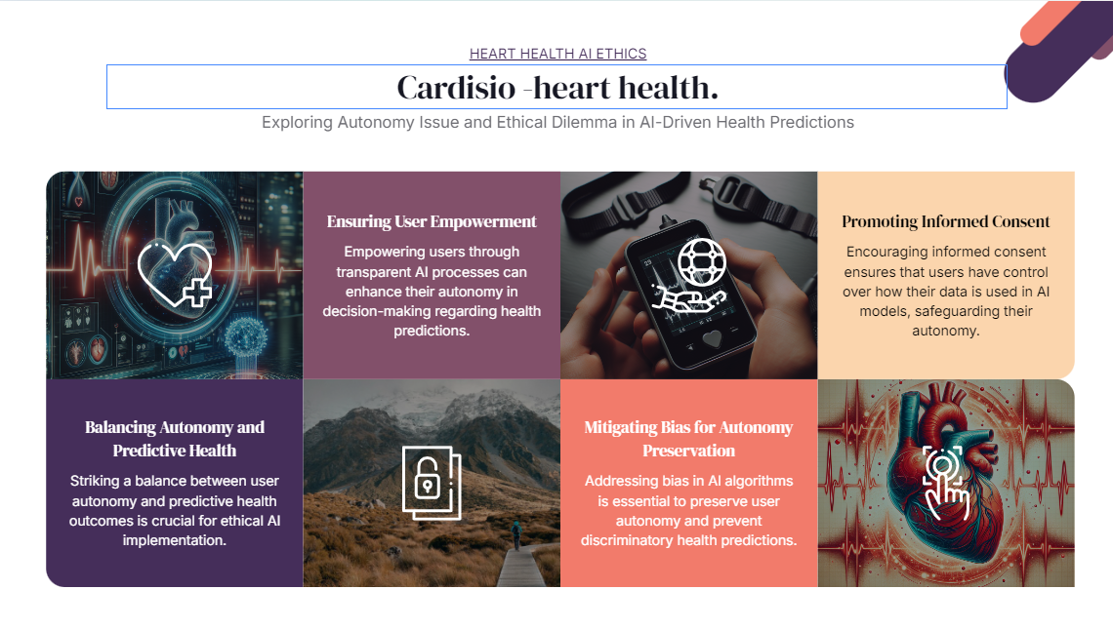
Notes:
We asked: Does Cardisio increase user autonomy? (versus biological health)
ML and big data task - machines can make better predictions than human doctors
Collected 1000s of EKG, health data, heart attacks, disease, no problems
Come to office you will not see a doctor - give you EKG - we will tell you what will happen to you with your heart health. Predictions, not exact, use percentages.
Very accurate and noninvasive and you get answers. What are the chances you have heart attack in next 5, 10, 20 years? That is what they did.
Came to ethics people, how does this machine work on human level? Tech level they got: EKG and predictions.
At first it seems like it helps freedom/autonomy, when you look more carefully maybe not… not help but takes away freedom.
How can we make this help your freedom?
Original output = Green/Red
For autonomy maximization: What should output be (percentages, colors…)? Add yellow?
Where are the thresholds?
Ex: 55 year old, X percentage risk for HA in 10 years. Is it currently green or red? When should I change my life? When are you painted as red? What percentage makes it red? They asked many questions like above. In this case they were trying to help the patients be more free. Where is the threshold? Is it diff based on age and gender? 2 years? 5 years? 10 years?
First proposal is have 3 colors. Green (good), Red (bad), Yellow (mid)
Users want simple! Not a lot of info! Overwhelming. Users dont want accuracy, they want to know how to live their life for the work to make sense.
This case is trying distinguish a ML helps you live your life versus evaluating for accuracy. Big list of possibilities does not help! Bridge statistics and human reality / translation. What is this translation? One translation is how we can increase freedom.

Slide 5
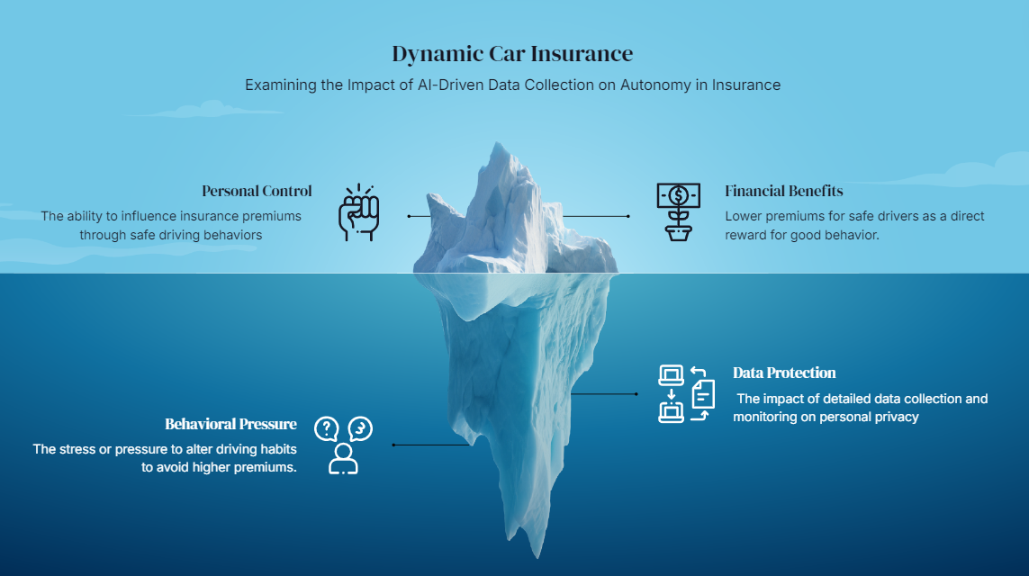

Slide 6
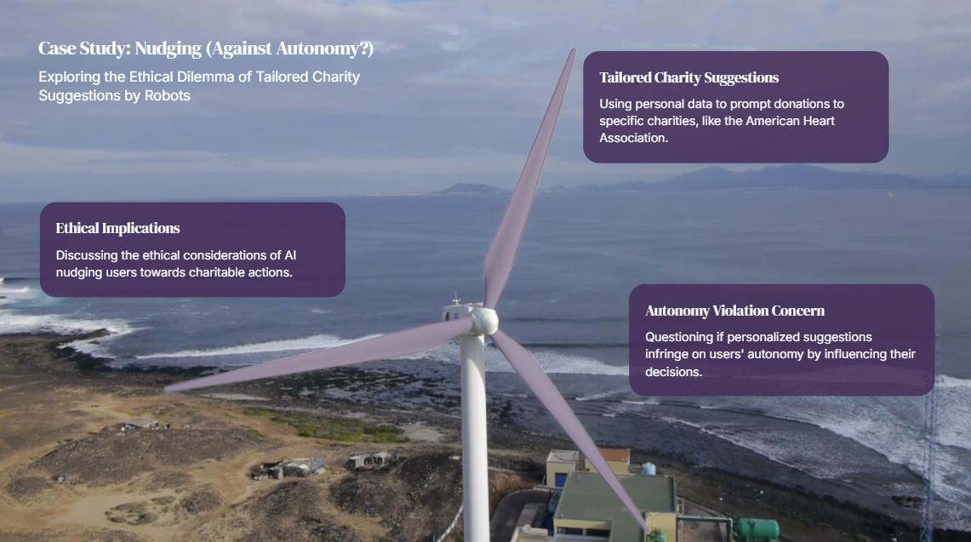

Slide 9
Notes:
Nudge is challenge against autonomy
surrendering part of their autonomy to the nudge created by AI.

Slide 10
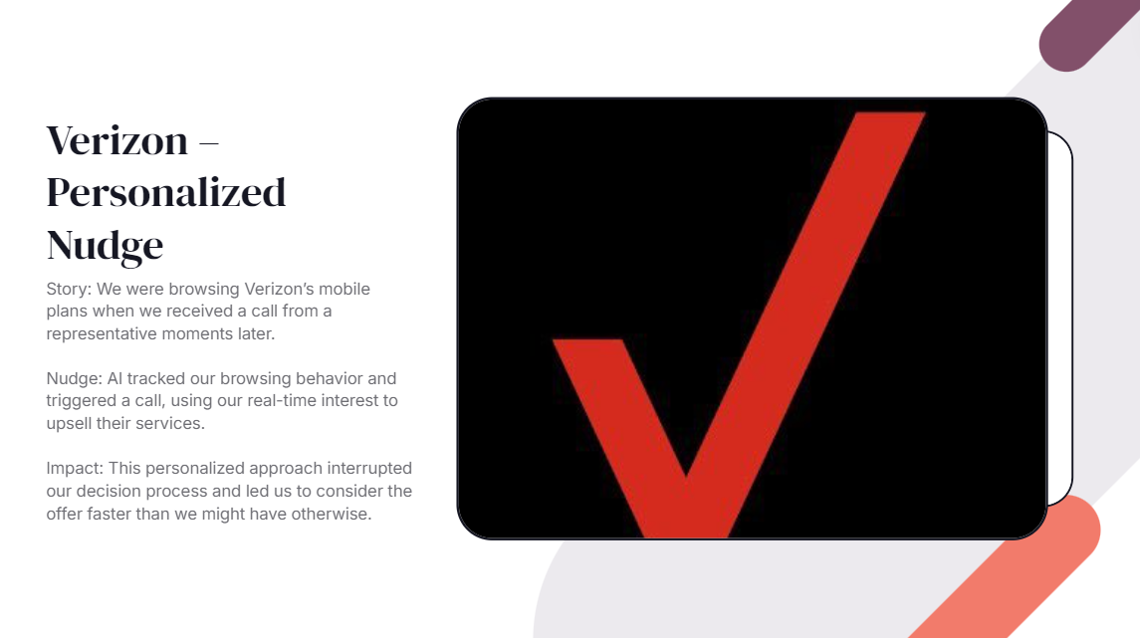
Notes:
limiting the time you might have taken to fully weigh all your options or consider alternative providers. Your autonomy was affected because the nudge pushed you towards quicker decision-making, possibly before you were ready.

Slide 11
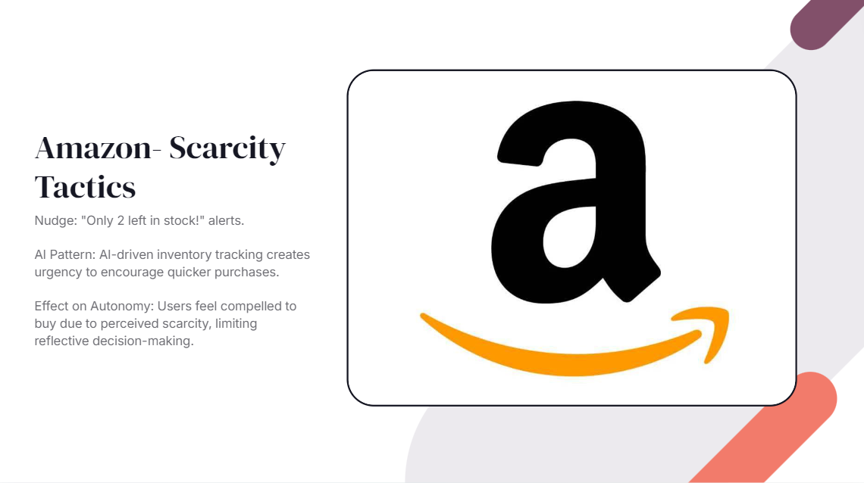
Notes:
he scarcity nudge pressures users into making quicker decisions, reducing the time available for thoughtful consideration. As a result, users' autonomy is compromised, as they may feel compelled to buy sooner than they might have if allowed more time to reflect on the purchase.

